Slide 1


FYP-II
Influencer Connect
Ayan Ahmed Siddiqui
Ansab Haider
Wajiha Ali
Supervisor: Sir Aamir Hussain
Department of Computing, FEST
Hamdard University

Slide 2
Summary
Problem Statement
Objective
FYP Scope
Our methodology
Our Project Plan (Time lines)
Budget / Costing (if any)
FYP Deliverables
Literature Review
Experimental Evaluations & Results
Test Plan & Test Cases
References

Slide 3
Problem Statement
Influencer marketing is a powerful tool for brands, but the current process of engaging influencers is cumbersome. Brands often rely on social media or email to connect with influencers, leading to inefficiencies and missed opportunities. "Influencer Connect" seeks to solve this problem by providing a dedicated platform where marketing agents can create and manage campaigns, and influencers can easily participate and communicate. This will enhance the overall effectiveness of influencer marketing campaigns, reduce time spent on coordination, and improve the collaboration between brands and influencers.

Slide 4
Objective
To develop a web-based platform that connects marketing agents with influencers, enabling efficient campaign management and streamlined communication.

Slide 5
FYP Scope
This project will focus on:
•User registration and profile management for marketing agents and influencers
•Campaign creation, management, and invitation system
•Real-time messaging between agents and influencers using SignalR
••Invoice generation for influencers participating in campaigns
The project will not cover:
•Advanced AI-based recommendations or matching algorithms
•Integration with external social media platforms beyond basic linking
•Detailed financial transactions and payment processing systems

Slide 6
Our Methodology
To address these challenges, we developed the platform using ASP.NET MVC for the web application framework and SQL Server as the backend database. The system includes user management, campaign creation, a real-time messaging system using SignalR, invoice generation, and an admin panel. A traditional Waterfall methodology was followed, where development was carried out in defined phases: requirement analysis, system design, implementation, and testing. This approach ensured structured progress and clarity at each stage of development.

Slide 7
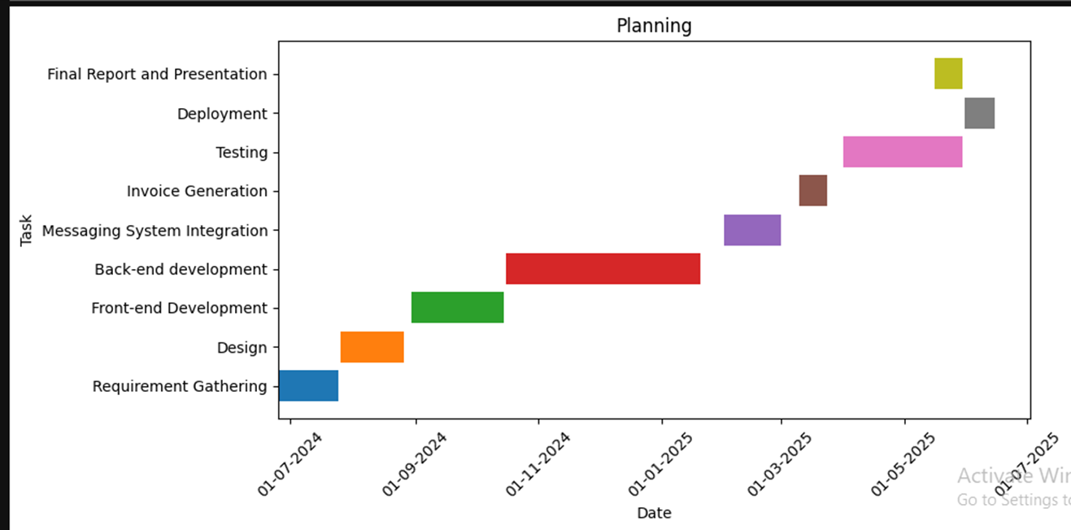
Our Project Plan

Slide 8
Budget / Costing
Component | Description | Estimated Cost (PKR)
Domain & Hosting | 1-year domain registration and shared/VPS hosting | 12,000
Development Effort | Approx. 300 hours by 3 developers (valued at PKR 300/hour) | 90,000
Design Tools & Assets | Icons, UI kits, stock images (free/premium) | 2,000
Demo Video Production | Editing tools, screen recording, voiceover | 3,000
Documentation & Printing | Final report, SRS, SDS, poster (digital or printed) | 2,000
Utilities & Miscellaneous | Backup storage, internet, electricity, testing tools | 1,500

Slide 9


FYP Deliverables
SRS Document
Budget Document
Project Plan
Front-end
Login Functionality for Both Influencer and Marketing Agent
Project Report (3 Chapters)
Back-end
Messaging System Integration
Invitation and Notification System
Testing
Deployment
Project Report Full

Slide 10
Literature Review
Influencer marketing has become a preferred strategy over traditional advertising due to its authenticity and ability to drive stronger consumer engagement. Research shows that audiences often perceive influencer content as more relatable and trustworthy, particularly among younger, digital-savvy users. However, managing influencer campaigns remains a major challenge, with many marketing agents relying on disconnected tools like spreadsheets and emails, leading to inefficiencies and miscommunication. Studies highlight the importance of real-time communication in improving collaboration and campaign outcomes. Technologies such as SignalR are identified as effective solutions to facilitate seamless, instant messaging between influencers and marketing agents.

Slide 11
Experimental Evaluations & Results
Test Environment:
Deployed on IIS with SQL Server 2019 and ASP.NET MVC.
Tested on diverse client setups with load testing via JMeter and security evaluation using OWASP ZAP.
Functional Testing:
Verified core modules: registration, role-based access, campaign creation, influencer search, invitations, and real-time messaging (SignalR).
Admin approval and campaign workflows functioned as expected.
Performance:
All major pages loaded within 1–3 seconds.
Real-time chat had <1s latency; filters and invitations processed within 2s.
System handled up to 10 concurrent users without lag or crashes.
Security:
Role-based access enforced, sensitive data protected, and CSRF tokens implemented.
Entity Framework used to prevent SQL injection. File upload restrictions validated.
Usability:
Interface found intuitive by test users.
Campaign creation and invitation processes were smooth and user-friendly.
Responsive design and error handling improved through feedback.

Slide 12
Test Plan & Test Cases
Test Case ID | Description | Expected Result | Status
TC-01 | Register as influencer | Redirects to dashboard after registration | Passed
TC-02 | Register as agent (not approved) | Agent redirected but restricted from creating campaigns or chatting | Passed
TC-03 | Agent creates a campaign | Campaign created and visible to influencers | Passed
TC-04 | Influencer accepts invitation | Status updated and reflected to agent | Passed
TC-05 | Real-time messaging between users | Message appears in chat window within 2 seconds | Passed
TC-06 | Unauthorized campaign creation by unapproved agent | Access denied and redirected | Passed
TC-07 | Admin approves a marketing agent | Agent can now access campaign creation features | Passed

Slide 13
Reference
Smith, J., & Johnson, L. (2023). Influencer Marketing in the Digital Age. Journal of Digital Marketing, 15(3), 45-60.
Patel, M., & Clark, S. (2024). Leveraging Influencers for Product Promotions: A Strategic Approach. Marketing Strategy Review, 12(4), 78-90.
Nguyen, T. (2022). Real-Time Messaging in Web Applications: A SignalR Approach. Web Development Journal, 18(2), 102-110.
Zeng, Y., & Wang, F. (2024). Building Scalable Platforms for Influencer Collaboration: Best Practices. International Conference on Web Technologies, 28(1), 150-160.

